Slide 1
Practical – 4 DevOps – Part 1
Aruna Kumbhar

Slide 2
https://classroom.google.com/c/ODcyMDU5MTU2OTYz?cjc=mls6kf2n

Slide 3
Introduction to CI using GitHub Actions
"Suppose 5 developers are working on an AIML project. Every time someone changes the code, should another developer manually check whether the program still works?"
Developer
↓
git push
↓
GitHub
↓
GitHub Actions
↓
Build
↓
Run Tests
↓
├── ✅ Pass
└── ❌ Fail
Continuous Integration
Continuous Integration = Automatically building and testing code whenever developers integrate their changes.

Slide 4
CI vs CD
CI: "Did my new code break the application?"
CD: "If everything is okay, can we automatically deliver/deploy it?"
CI = Build + Test
CD = Deliver/Deploy
CI/CD = Automate the journey from code to deployment

Slide 5
GitHub Actions
GitHub Actions is a CI/CD automation service provided by GitHub
Term | Simple meaning
Workflow | Complete automation process
Event/Trigger | What starts the workflow
Job | A major task
Step | Individual instruction
Runner | Machine that executes the job
Action | Reusable automation component

Slide 6
Think of GitHub Actions as a robot assistant that lives inside your GitHub repository. Every time something happens in your repo (like pushing code, creating a pull request, or tagging a release), this robot wakes up and performs tasks for you — automatically
The "Coffee Shop" Analogy ☕
Imagine you own a coffee shop:
Your repository = The coffee shop
Events = A customer walking in, an order being placed, a delivery arriving
Workflows = The recipe cards that tell staff what to do when something happens
Actions = Pre-made ingredients or tools (like pre-ground coffee, pre-made syrups)
Runners = The actual baristas who do the work

Slide 7
Example
College analogy
Workflow = Complete ASDD practical
Job = One experiment (e.g. Git & GitHub)
Step = Individual activity (e.g. pushing code to repository)
Runner = Lab computer
Trigger = Bell announcing the practical

Slide 8
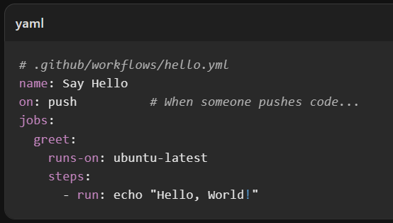
1. Workflow 📋
Git Push
↓
GitHub Actions
↓
Start Runner
↓
Setup Python
↓
Run Program
↓
Show Result
A workflow is an automated process defined in a YAML file (.github/workflows/*.yml). It's like a recipe that says: "When X happens, do Y, then Z."

Slide 9
2. Event 🔔
An event is what triggers your workflow. It's the "When this happens..." part

Slide 10
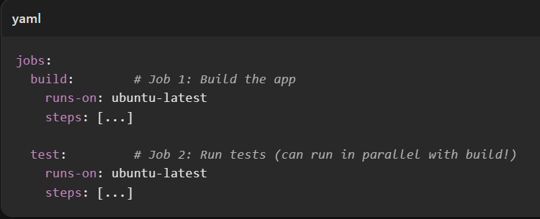
3. Job 👷
A job is a set of steps that run on the same machine. Jobs can run:
Sequentially (one after another) — "Build first, then deploy"
In parallel (at the same time) — "Run tests on Linux, Windows, and Mac simultaneously"

Slide 11
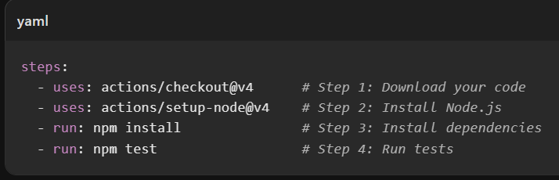
4. Step 🪜
A step is a single task inside a job. Steps run one after another. Each step is either:
A shell command you write (run: npm test)
An Action you use (uses: actions/checkout@v4)

Slide 12
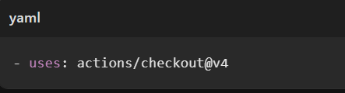
5. Action 🧩
An Action is a reusable, pre-built automation block that someone else (or you) created. Instead of writing 50 lines of shell script to clone your repo, you just say:
Popular official Actions:
actions/checkout@v4 — Downloads your repository code
actions/setup-node@v4 — Installs Node.js
actions/upload-artifact@v4 — Saves files (build outputs, test reports)
actions/cache@v4 — Speeds up builds by caching dependencies

Slide 13
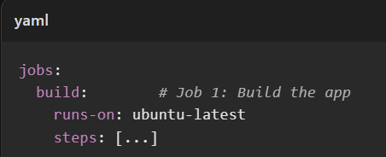
6. Runner 🖥️
A runner is the virtual machine that actually executes your workflow. GitHub provides them for free:
You can also use your own servers as "self-hosted runners" if you need special hardware or security

Slide 14
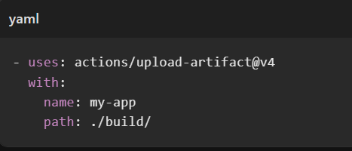
7. Artifact 📦
An artifact is a file produced by your workflow that you want to keep. Like a build log, a compiled app, or test screenshots.

Slide 15
name: Build and Deploy
on:
push:
branches: [main] # Trigger: push to main branch
jobs:
build-and-deploy:
runs-on: ubuntu-latest # Runner: Linux machine
steps:
# Step 1: Get the code
- uses: actions/checkout@v4
# Step 2: Set up Node.js
- uses: actions/setup-node@v4
with:
node-version: '20'
# Step 3: Install dependencies
- run: npm ci
# Step 4: Run tests
- run: npm test
# Step 5: Build the app
- run: npm run build
# Step 6: Deploy to production
- run: npm run deploy

Slide 16
1. Create a repository “devops-demo” on Github
2. Add a file “hello.py”
print("Hello from DevOps!")
3. Then create the workflow
.github
.github/workflows/ci.yml
workflows
ci.yml
This is where the automation is defined

Slide 17
name: First CI Pipeline
on:
push:
jobs:
build:
runs-on: ubuntu-latest
steps:
- name: Checkout code
uses: actions/checkout@v4
- name: Setup Python
uses: actions/setup-python@v5
with:
python-version: '3.12'
- name: Run program
run: python hello.py
ci.yml
Push → Watch → Celebrate 🎉

